Slide 1

Java Data Types, Variables, Arrays Java - The Complete Reference Herbert Schildt Chapter 3

Slide 2
Outline
Java Data Types
Java Literals
Java Variables
Type Casting and Type Promotion in Java
Arrays

Slide 3
Java Data Types

Slide 4
Java is a Strongly Typed Language
In Strongly Typed languages, variable types are checked at compile time and cannot be changed at runtime.
Java, C#, C/C++, Swift, Kotlin
In Dynamically Typed languages, variable types are determined at runtime and can change during execution.
JavaScript, Python, Ruby, Perl, PHP
Every variable in Java has a type, every expression has a type, and every type is strictly defined.
All assignments, whether explicit or via parameter passing in method calls, are checked for type compatibility.
Any type mismatches are errors that must be corrected before the compiler will finish compiling the class.

Slide 5
Primitive Data Types
Eight (8) primitive (simple) types can be grouped into four:
The primitive types represent single values—not complex objects.
Integers | Floating-points | Characters | Booleans
byte, short, int, long | float, double | char | boolean
Used for whole-valued signed numbers | Used for numbers with fractional precision. | Used for symbols in a character set, like letters, digits, special symbols, etc. | Used for true/false values.

Slide 6
Strictly Defined Range of Primitive Data Types
The primitive types are defined to have an explicit range and mathematical behavior.
Languages such as C and C++ allow the size of an integer to vary based on the execution environment.
32-bit/64-bit systems, int is usually 32 bits. (Windows, Linux, etc.)
16-bit systems (older systems or embedded platforms), int might be 16 bits (consumer electronics, automotive electronics, control systems).
Because of Java’s portability requirement, all data types have a strictly defined range.
For example, an int is always 32 bits, regardless of the particular platform.
This allows programs to be written that are guaranteed to run without porting on any machine architecture.

Slide 7
Integers (byte, short, int, long)
All of these are signed, positive and negative values.
Java does not support unsigned, positive-only integers (as in C/C++, C#, Python).
Name | Width (bytes) | Range
byte | 1 | –128 to 127
Short | 2 | –32,768 to 32,767
int | 4 | –2,147,483,648 to 2,147,483,647
long | 8 | –9,223,372,036,854,775,808 to 9,223,372,036,854,775,807

Slide 8
Integers (byte, short, int, long)
byte
Variables of type byte are especially useful when reading or writing with a stream of data from a file or network.
Also, useful when working with raw binary data that may not be directly compatible with Java’s other built-in types.
short
It is probably the least used Java type.
int
In addition to other uses, variables of type int are commonly employed to control loops and to index arrays.
long
Useful for those occasions where an int type is not large enough to hold the desired value.
Code: LongExample.java

Slide 9
Floating-point Types (float, double)
Floating-point numbers, also known as real numbers, are used when evaluating expressions that require fractional precision.
Examples: calculations such as square root, or trigonometric functions such as sine and cosine.
Name | Width (bytes) | Range
float | 4 | 1.4e–045 to 3.4e+038
double | 8 | 4.9e–324 to 1.8e+308

Slide 10
Floating-point Types (float, double)
float
Specifies a single-precision value.
Single precision is faster on some processors and takes half as much space as double precision.
But will become imprecise when the values are either very large or very small.
Variables of type float are useful when you need a fractional component, but don’t require a large degree of precision.
For example, float can be useful when representing dollars and cents.
double
Double precision is actually faster than single precision on some modern processors that have been optimized for high-speed mathematical calculations.
All transcendental math functions, such as sin( ), cos( ), and sqrt( ), return double values.
When you need to maintain accuracy over many iterative calculations, or are manipulating large-valued numbers, double is the best choice.

Slide 11
Floating-point Types (float, double)
float
Specifies a single-precision value.
Single precision is faster on some processors and takes half as much space as double precision.
But will become imprecise when the values are either very large or very small.
Variables of type float are useful when you need a fractional component, but don’t require a large degree of precision.
For example, float can be useful when representing dollars and cents.
double
Double precision is actually faster than single precision on some modern processors that have been optimized for high-speed mathematical calculations.
All transcendental math functions, such as sin( ), cos( ), and sqrt( ), return double values.
When you need to maintain accuracy over many iterative calculations, or are manipulating large-valued numbers, double is the best choice.
Code: ComputeArea.java

Slide 12
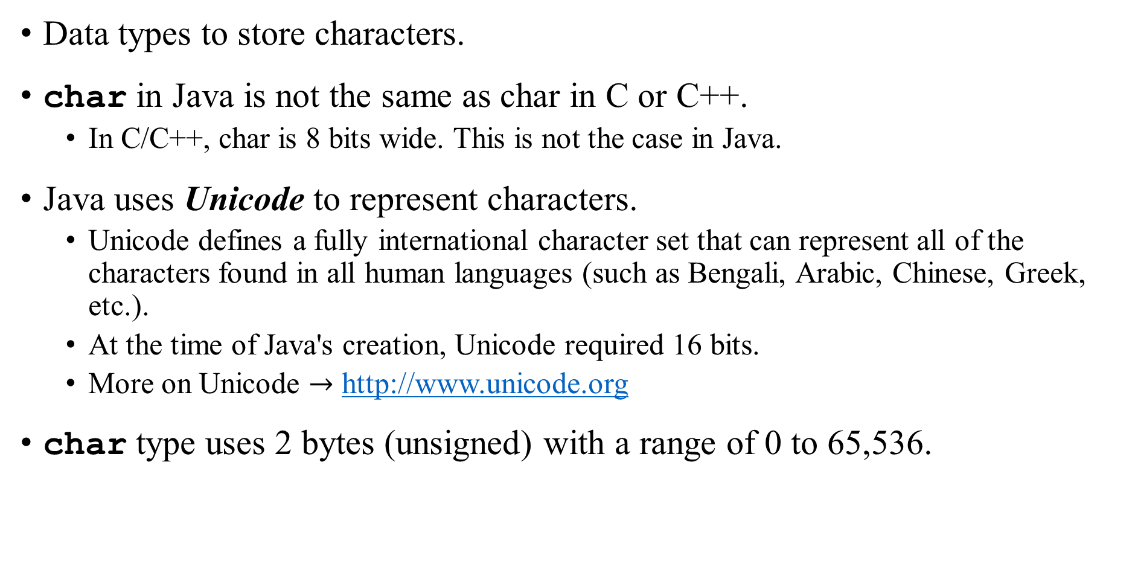
Characters (char)
Data types to store characters.
char in Java is not the same as char in C or C++.
In C/C++, char is 8 bits wide. This is not the case in Java.
Java uses Unicode to represent characters.
Unicode defines a fully international character set that can represent all of the characters found in all human languages (such as Bengali, Arabic, Chinese, Greek, etc.).
At the time of Java's creation, Unicode required 16 bits.
More on Unicode $→$ http://www.unicode.org
char type uses 2 bytes (unsigned) with a range of 0 to 65,536.

Slide 13
Characters (char)
The standard set of characters known as ASCII still ranges from 0 to 127 as always, and the extended 8-bit character set, ISO-Latin-1, ranges from 0 to 255.
Since Java is designed to allow programs to be written for worldwide use, it makes sense that it would use Unicode to represent characters.
Code: CharDemo.java
char can also be used as an integer type on which you can perform arithmetic operations.
For example, you can add two characters together, or increment the value of a character variable.
Code: CharDemo2.java

Slide 14
Booleans (boolean)
Primitive type boolean is used for logical values.
Only one of two possible values: true or false
This is the type returned by all relational operators, as in the case of a < b.
boolean is also the type required by the conditional expressions that govern the control statements such as if and for.
Code: BoolTest.java
When a boolean value is output by println(), true or false is displayed.
The value of a boolean variable is sufficient to control the if statement. There is no need to write an if statement like this: if(b == true)
The outcome of a relational operator, such as <, is a boolean value.

Slide 15
Java Literals

Slide 16
Integer Literals
Any whole number value is an integer literal.
Three bases can be used:
Decimal (base 10): Written without leading 0. Examples 1, 2, 3, and 42.
Octal (base 8): Written with a leading 0. Examples 012, 0436.
Hexadecimal (base 16): Written with a leading 0x or 0X. Examples 0X2a, 0xCODE.
Binary (base 2): Written with a leading 0b or 0B. Examples 0B1010, 0b11010.
Integer literals create a 32-bit integer value.
Since Java is strongly typed, how it is possible to assign an integer literal to one of Java’s other integer types (i.e., byte or long) without causing a type mismatch error?
When a literal value is assigned to a byte or short variable, no error is generated if the literal value is within the range of the target type.
An integer literal can always be assigned to a long variable.

Slide 17
Integer Literals
A long literal can be created by appending an upper- or lowercase L to the literal:
Examples: 0x7ffffffffffffffL or 9223372036854775807L (the largest long value).
An integer literal can also be assigned to a char as long as it is within range.
One or more underscores can be embedded in an integer literal (for ease of reading of large integer literals) [compilation process discards underscores].
Example: int x = 123_456__789; // the value given to x will be 123456789
Underscores cannot come at the beginning or the end of a literal.
Underscores are useful for providing visual groupings when specifying binary literals.
Example: int x = 0b1101_0101_0001_1010;

Slide 18
Floating-point Literals
Floating-point numbers represent decimal values with a fractional component.
Standard notation: Examples 2.0, 3.14159, and 0.6667
Scientific notation: Examples 6.022E23, 314159E–05, and 2e+100.
Floating-point literals in Java default to double precision.
To specify a float literal, an F or f must be appended to the constant [consumes 32 bits].
To specify a double literal explicitly, a D or d must be appended to the constant (redundant) [consumes 64 bits].
Underscores can be embedded for ease of readability (like integer literals)
Example: double num1 = 9_423_497_862.0;
Example: double num2 = 9_423_497.1_0_9;

Slide 19
Boolean Literals
Only two logical values: true and false.
The values of true and false do not convert into any numerical representation (unlike C/C++).
The true literal in Java does not equal 1, nor does the false literal equal 0.
In Java, the Boolean literals can only be assigned to variables declared as boolean or used in expressions with Boolean operators.

Slide 20
Character Literals
A literal character is represented inside a pair of single quotes (like C/C++).
All of the visible ASCII characters can be directly entered inside the quotes, such as 'a', 'z', and '@'.
Escape Sequences are used for characters that are impossible to enter directly.
Example: '\'' for single-quote and '\n' for newline character.
For entering the value of a character in octal, use the backslash followed by the three-digit number.
Example: '\141' is the letter 'a'
For entering the value of a character in hexadecimal, use the backslash-u (\u) followed by exactly four hexadecimal digits.
Example: '\u0061' is the ISO-Latin-1 'a'
Example: '\ua432' is the Japanese Katakana character (フィ) [fu i]

Slide 21
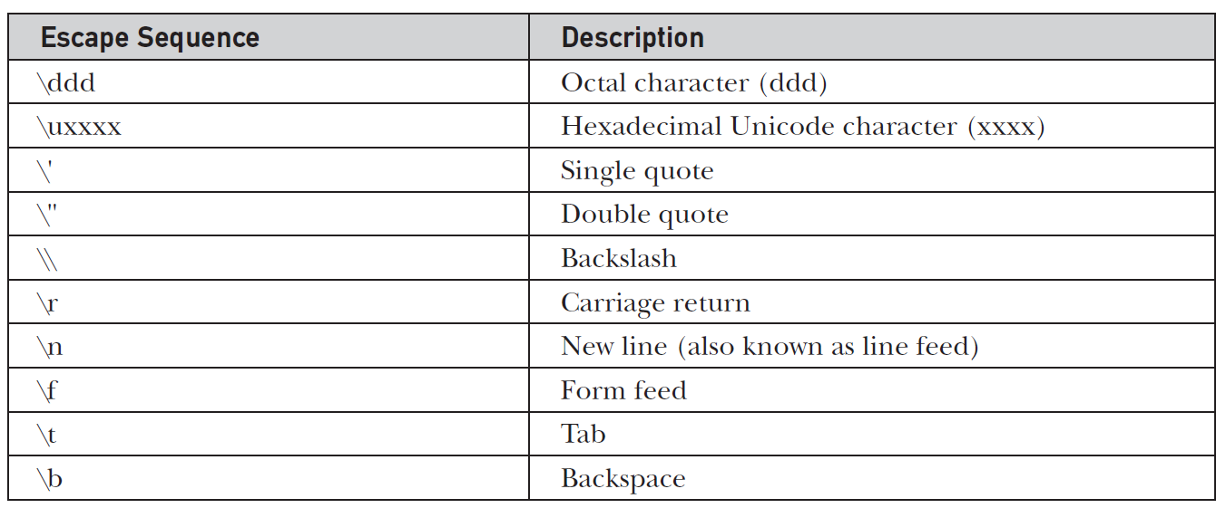
Escape Sequences

Slide 22
String Literals
String literals are specified by enclosing a sequence of characters between a pair of double quotes (" ").
Examples: "Hello World" , "two\nlines" , "\"This is in quotes\""
The escape sequences and octal/hexadecimal notations that were defined for character literals work the same way inside of string literals.
One important thing to note about Java strings is that they must begin and end on the same line.
There is no line-continuation escape sequence as there is in some other languages (as the backslash character \ in C/C++).
Unlike other languages (i.e., C/C++), strings in Java are not implemented as arrays of characters, rather Strings are actually object types.
As a result, Java includes extensive string-handling capabilities that are both powerful and easy to use.

Slide 23
Variables in Java

Slide 24
Variables
The variable is the basic unit of storage in a Java program.
A variable is defined by the combination of an identifier, a type, and an optional initializer.
All variables have a scope, which defines their visibility, and a lifetime.

Slide 25
Variable Declaration
In Java, all variables must be declared before they can be used. (unlike JavaScript, Python, PHP, Ruby, Perl, R, Lua).
type identifier [ = value ][, identifier [= value ] …];
Here, type is one of Java’s atomic types, or the name of a class or interface.
int a, b, c; // declares three ints, a, b, and c. int d = 3, e, f = 5; // declares three more ints, initializing d & f byte z = 22; // initializes z. double pi = 3.14159; // declares an approximation of pi. char x = 'x’; // the variable x has the value 'x'.

Slide 26
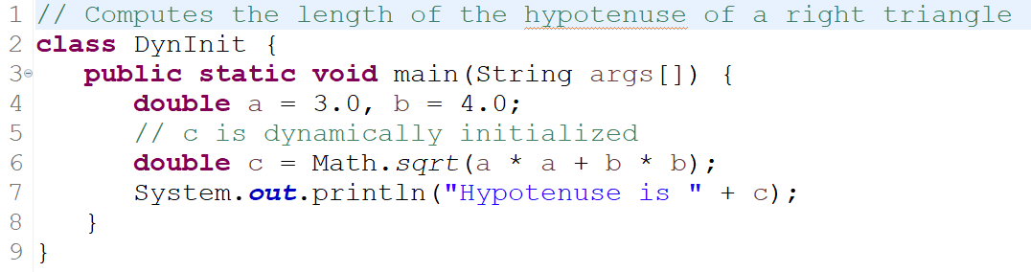
Dynamic Initialization
Java allows variables to be initialized dynamically, using any expression valid at the time the variable is declared.
sqrt(), a Java’s built-in method (a member of the Math class), computes the square root of its argument.
The initialization expression may use any element valid at the time of the initialization, including calls to methods, other variables, or literals.

Slide 27
Scope and Lifetime of Variables
Java allows variables to be declared within any block, not just at the beginning.
A block is begun with an opening curly brace { and ended by a closing curly brace }.
A block defines a scope.
Thus, each time a new block is started, a new scope is created.
A scope determines what objects are visible to other parts of your program.
It also determines the lifetime of those objects (including variables).
Many languages (including C/C++) create two main scopes: global and local
In Java, the two major scopes are those defined by a class and those defined by a method.

Slide 28
Scope Defined within a Method
The scope defined by a method begins with its opening curly brace.
This includes any parameters passed to the method.
As a general rule, variables declared inside a scope are not visible (that is, accessible) to code that is defined outside that scope.
Thus, when a variable is declared within a scope, it is localized and protected from unauthorized access and/or modification.
Scopes can be nested
Each time a block of code is created, a new, nested scope is created.
When this occurs, the outer scope encloses the inner scope.
This means that objects declared in the outer scope will be visible to code within the inner scope.
However, the reverse is not true. Objects declared within the inner scope will not be visible outside it.

Slide 29
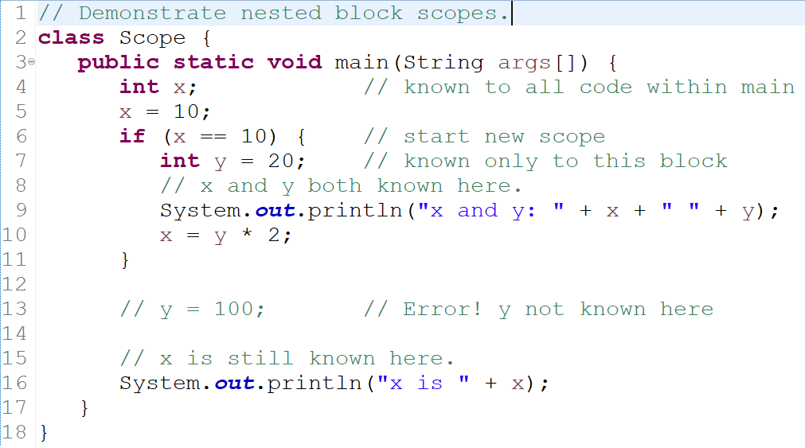
Nested Scope: Example

Slide 30
Lifetime of a Variable
Variables are created when their scope is entered and destroyed when their scope is left.
This means that a variable will not hold its value once it has gone out of scope.
Therefore, variables declared within a method will not hold their values between calls to that method.
Also, a variable declared within a block will lose its value when the block is left.
Thus, the lifetime of a variable is confined to its scope.
If a variable declaration includes an initializer, then that variable will be reinitialized each time the block in which it is declared is entered.

Slide 31
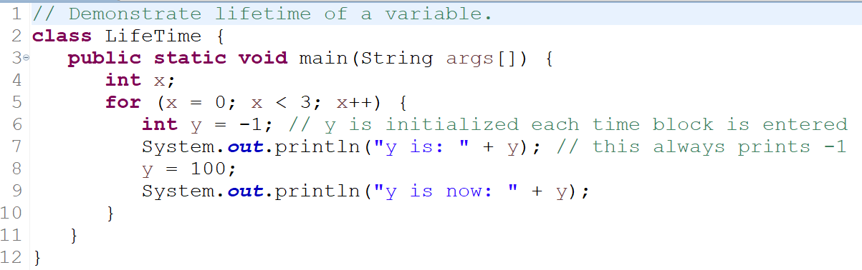
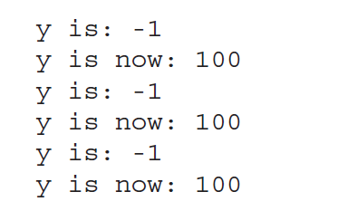
Lifetime of a Variable: Example
Output

Slide 32
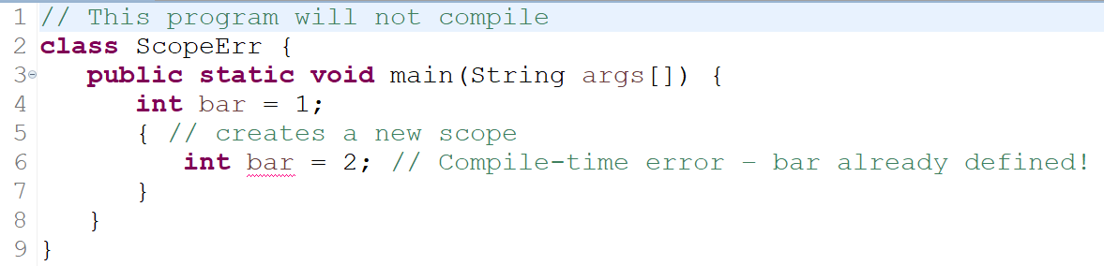
Variable Names in Nested Scope
Although blocks can be nested, a variable can not be declared to have the same name as one in an outer scope.

Slide 33
Type Conversions and Casting

Slide 34
Type Conversion Compatibility
In programming, it is fairly common to assign a value of one type to a variable of another type.
If the two types are compatible, then Java will perform the conversion automatically (implicitly).
Example: it is always possible to assign an int value to a long variable.
However, not all types are compatible, and thus, not all type conversions are implicitly allowed.
Example: there is no automatic conversion defined from double to byte.
Fortunately, it is still possible to obtain a conversion between incompatible types using casting.
A Type Casting performs an explicit conversion between incompatible types.

Slide 35
Java’s Automatic Conversions
When one type of data is assigned to another type of variable, an automatic type conversion will take place if the following two conditions are met:
Compatibility: The two types are compatible.
Size: The destination type is larger than the source type.
When these two conditions are met, a widening conversion takes place.
Example, the int type is always large enough to hold all valid byte values, so no explicit cast statement is required.
For widening conversions, the numeric types, including integer and floating-point types, are compatible with each other.
However, there are no automatic conversions from the numeric types to char or boolean.
Also, char and boolean are not compatible with each other.
Java also performs an automatic type conversion when storing a literal integer constant into variables of type byte, short, long, or char.

Slide 36
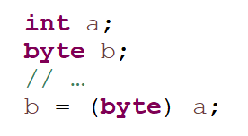
Casting Incompatible Types
What if we want to assign an int value to a byte variable?
This conversion will not be performed automatically, because a byte is smaller than an int.
This is explicitly making the value narrower so that it will fit into the target type (Narrowing Conversion).
To create a conversion between two incompatible types, we must use a cast.
A cast is simply an explicit type conversion:
Example:
If the integer’s value is larger than the range of a byte, it will be reduced modulo (the remainder of an integer division by the) byte’s range.

Slide 37
Casting Incompatible Types
A different type of conversion will occur when a floating-point value is assigned to an integer type: truncation - as integers do not have fractional components.
Example: if the value 1.23 is assigned to an integer, the resulting value will simply be 1.
If the size of the whole number component is too large to fit into the target integer type, then that value will be reduced modulo the target type’s range.

Slide 38
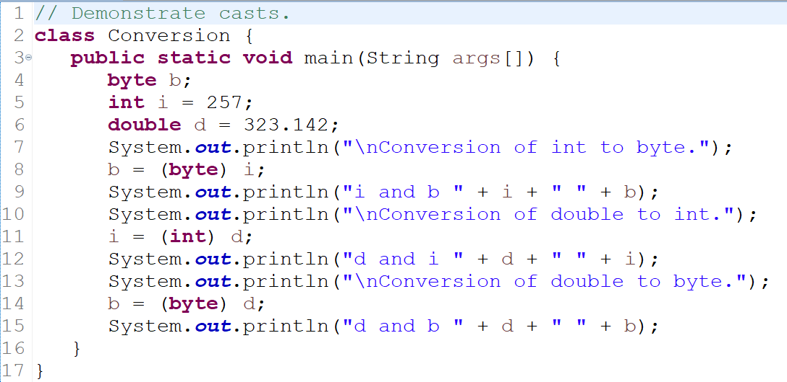
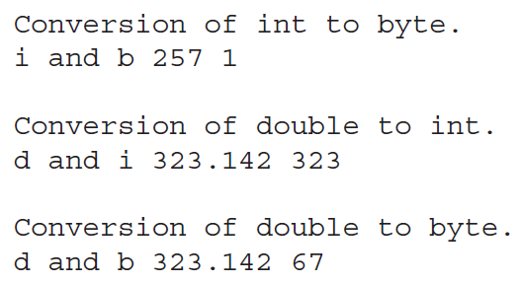
Casting Incompatible Types: Example
Output
int to byte conversion: 257 % 256 = 1
double to byte : 323 % 256 = 67

Slide 39
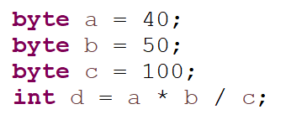

Automatic Type Promotion in Expressions
Type conversions may also occur in expressions.
In an expression, the precision required of an intermediate value will sometimes exceed the range of either operand.
Example:
The result of the intermediate term a*b easily exceeds the range of either of its byte operands.
To handle this kind of problem, Java automatically promotes each byte, short, or char operand to int when evaluating an expression.
However, the automatic promotions can sometime cause confusing compile-time errors.
Example:
Solution is to use type casting:

Slide 40
Automatic Type Promotion in Expressions
Java defines several type promotion rules that apply to expressions:
First, all byte, short, and char values are promoted to int.
Then, if one operand is a long, the whole expression is promoted to long.
If one operand is a float, the entire expression is promoted to float.
If any of the operands are double, the result is double.

Slide 41
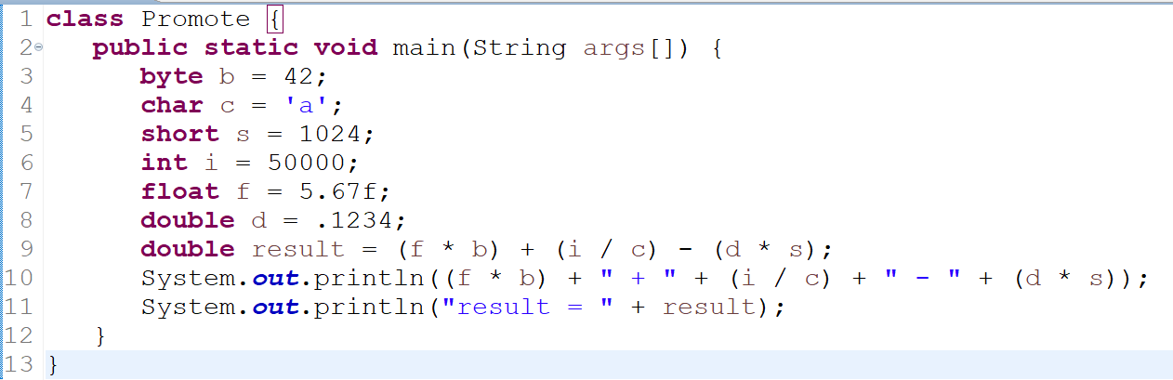
Automatic Type Promotion in Expressions: Example
In the first subexpression, f * b, b is promoted to a float and the result of the subexpression is float.
Next, in the subexpression i/c, c is promoted to int, and the result is of type int.
Then, in d * s, the value of s is promoted to double, and the type of the subexpression is double.
Finally, these three intermediate values, float, int, and double, are considered.
The outcome of float plus an int is a float.
Then the resultant float minus the last double is promoted to double, which is the type for the final result of the expression.

Slide 42
Arrays

Slide 43
Arrays
An array is a group of like-typed variables that are referred to by a common name.
A specific element in an array is accessed by its index.
Arrays offer a convenient means of grouping related information.
In Java, arrays are implemented as objects (unlike C/C++).

Slide 44
One-Dimensional Arrays
A list of like-typed variables.
To create an array, first create an array variable of the desired type.
General form:
type var-name[ ];
Example:
int month_days[];
Note that, with the above declaration, no array is actually created.
To create the actual array, allocate the array using new keyword:
month_days = new int[12]; //
new is a special operator that allocates memory. Here, the array size is 12.

Slide 45
One-Dimensional Arrays
When using new, the elements will automatically be initialized to -
zero for numeric types,
false for boolean types, and
null for reference types.
Array index starts at 0.
In Java, all arrays are dynamically allocated.
Code: OneDArray.java

Slide 46
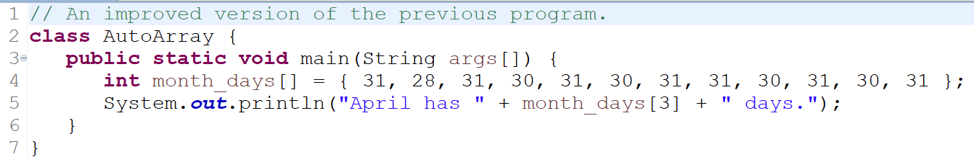
Array Initialization
Arrays can be initialized when they are declared.
An array initializer is a list of comma-separated expressions surrounded by curly braces.

Slide 47
Indexing Array Out Of Bounds
Java strictly checks to make sure index value does not go out of the range.
When trying to access elements outside the range of the array (negative numbers or numbers greater than the length of the array), it causes a run-time error.
Code: IndexOutOfBounds.java

Slide 48
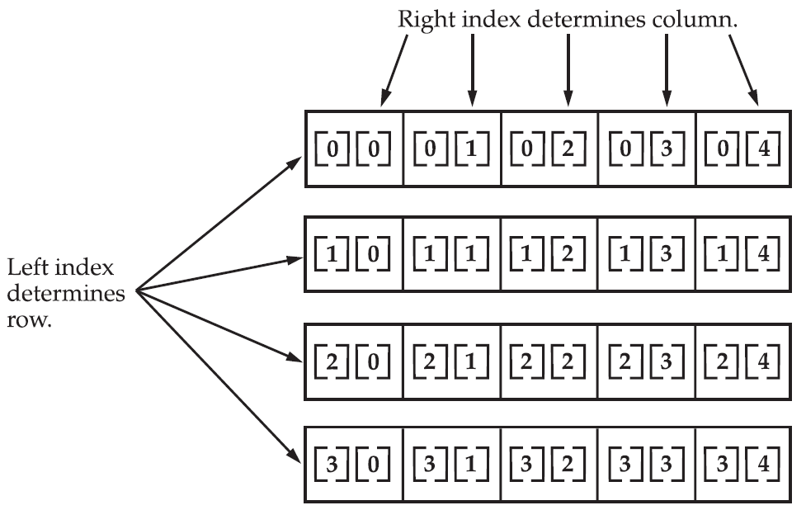
Multidimensional Arrays
In Java, multidimensional arrays are actually arrays of arrays.
They look and act like regular multidimensional arrays (as in C/C++), but there are a couple of subtle differences.
Example:
int twoD[][] = new int[4][5];

Slide 49
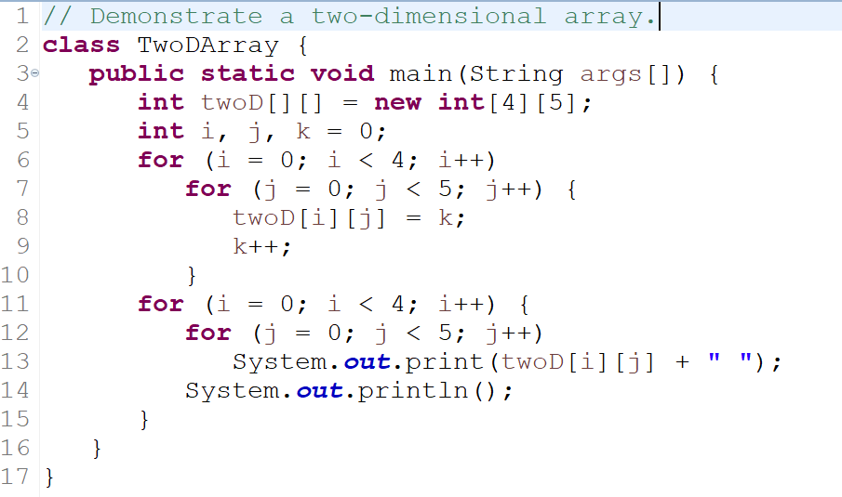
Two-dimensional Array
The following program assigns numbers each element in the array from left to right, top to bottom, and then displays these values.

Slide 50
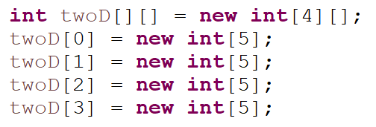
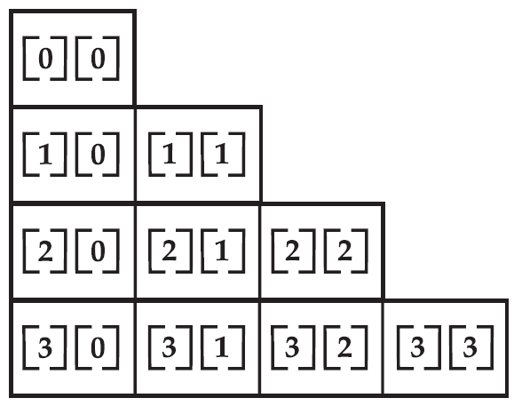
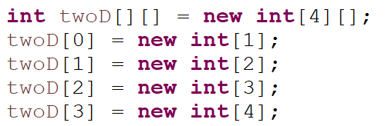
More on Multidimensional Array
For a multidimensional array, we need only specify the memory for the first (leftmost) dimension.
We can allocate the remaining dimensions separately.
When allocating manually, each dimension can have different number of elements. Such arrays are called Irregular/Ragged Arrays.
Irregular arrays can be used effectively in some situations. Example, if you need a very large two-dimensional array that is sparsely populated (that is, one in which not all of the elements will be used).

Slide 51
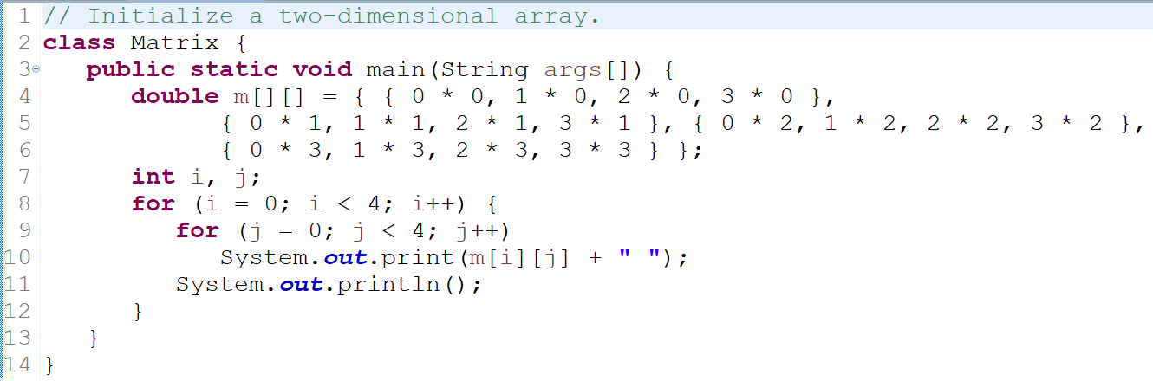
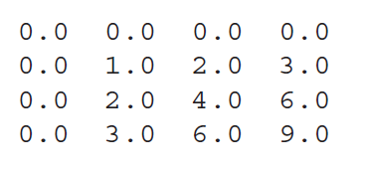
Initializing Multidimensional Array
Simply enclose each dimension’s initializer within its own set of curly braces.
Output

Slide 52
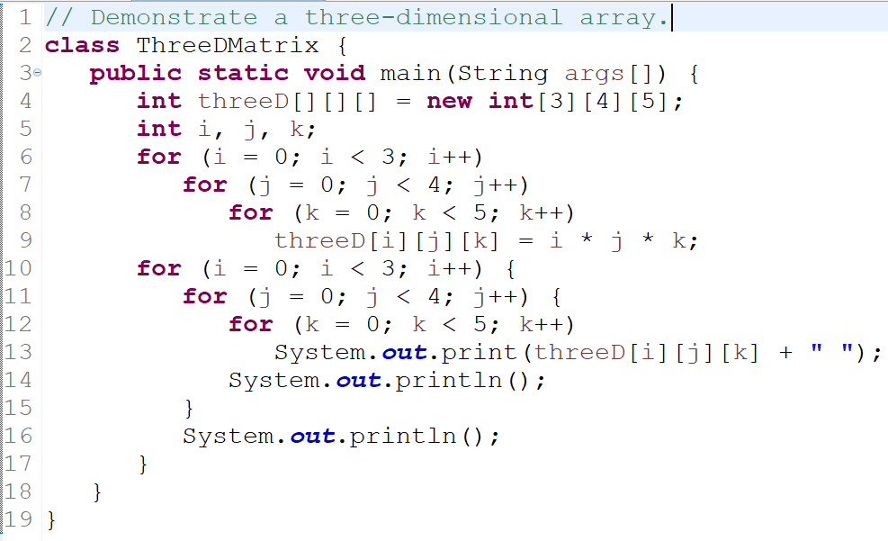
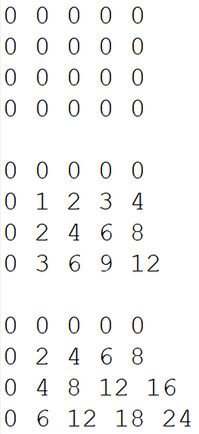
Three-dimensional Array
Output

Slide 53
Alternative Array Declaration Syntax
General form:
type[] var-name;
The following two declarations are equivalent:
int al[] = new int[3];
int[] a2 = new int[3];
The following declarations are also equivalent:
char twod1[][] = new char[3][4];
char[][] twod2 = new char[3][4];
This alternative declaration form offers convenience when declaring several arrays at the same time.
int[] nums1, nums2, nums3;
The alternative declaration form is also useful when specifying an array as a return type for a method:
int[] myMethod();

Slide 54
A Few Words About Strings
Java’s string type, called String, is not a primitive type.
Nor is it simply an array of characters.
String is a class defined in Java Standard Library and is used to create string objects (or variables).
We can also declare arrays of strings.
A quoted string constant can be assigned to a String variable.
A variable of type String can be assigned to another variable of type String.
You can use an object of type String as an argument to println( ) method:
String str = "this is a test"; // here str is an object of type String
System.out.println(str);

Slide 55
A Note to C/C++ Programmers About Pointers
Java does not support or allow pointers.
More properly, Java does not support pointers that can be accessed and/or modified by the programmer.
Java cannot allow pointers, because doing so would allow Java programs to breach the firewall between the Java execution environment (JVM) and the host computer.
Note that a pointer can be given any address in memory — even addresses that might be outside the Java run-time system.
Since C/C++ make extensive use of pointers, one might think that their loss is a significant disadvantage to Java.
However, this is not true. Java is designed in such a way that as long as we stay within the confines of the execution environment, you will never need to use a pointer, nor would there be any benefit in using one.

